Slide 1
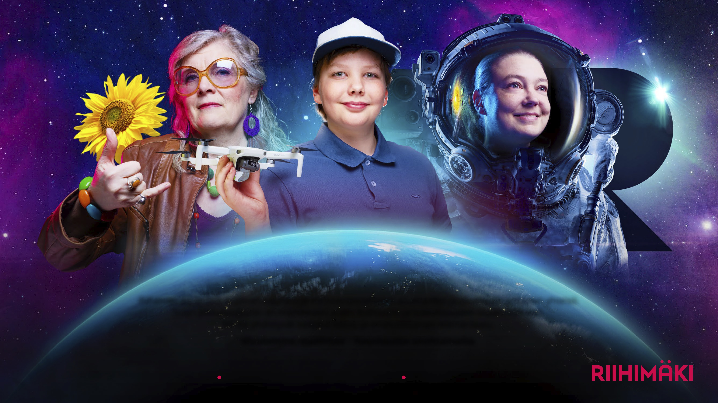
RAKA SRIKSU2035 STR ATE GY
PROMPTNESS
COURAGE
FAIRNESS
Solar system’s
finest and bravest
Riihimäki is the solar system’s finest and bravest – a community of happy residents and outstanding companies. Our big little city is the home of meaningful everyday life, culture, and future skills.
We combine sustainable growth with first-class quality of life.
We change the world – and keep it fun.
IRRESISTIBLE 15-MINUTE CITY
THE HOME OF FUTURE-MAKERS
SUSTAINABLE GROWTH COMMUNITY

Slide 2
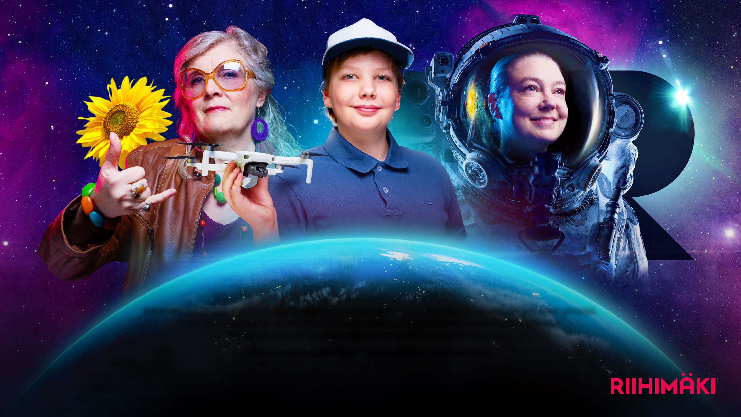
RAKA SRIKSU2035 STR ATE GY: VALUES
PROMPTNESS
COURAGE
FAIRNESS
We act efficiently and transparently for the benefit of citizens and businesses. We proactively identify the needs of citizens and businesses and help them in their daily lives.
We trust in the creativity, prosperity, and opportunities that we shape together. We create solutions that benefit both the people and the planet. We dare to dream and experiment, and trust in the power of our community.
We serve in a friendly, fair, and uncomplicated way. We act confidentially, and understand diversity.

Slide 3
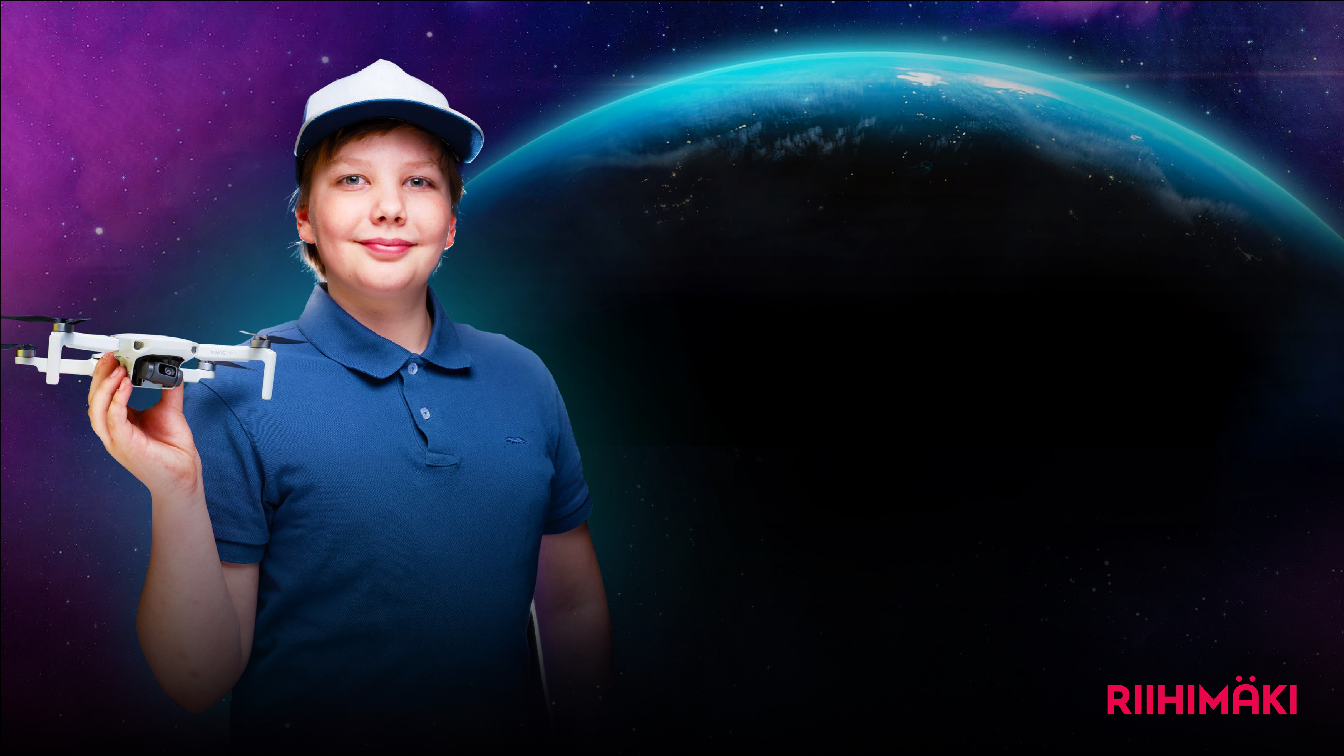
RAKA SRIKSU2035
STR ATE GY: OBJECTIVES
We develop Riihimäki as a human-sized, child-friendly, compact railway junction city. Our everyday life is easy-going, and our services are within short walking or cycling distances.
We offer versatile, high-quality living options and services for our existing and new residents.
We make use of our excellent location and transport connections by the mainline railway and motorway E12.
We are building a comfortable, accessible, and safe urban environment where residents can enjoy parks, green spaces, and recreation areas. We support sustainable transport modes.
We invite our residents to actively participate in the development of their living environment.
We provide plentiful, excellent cultural and sports events and activities, both for our residents and for our visitors.
We preserve our rich local history.
PROMPTNESS
Irresistible
15-minute city

Slide 4
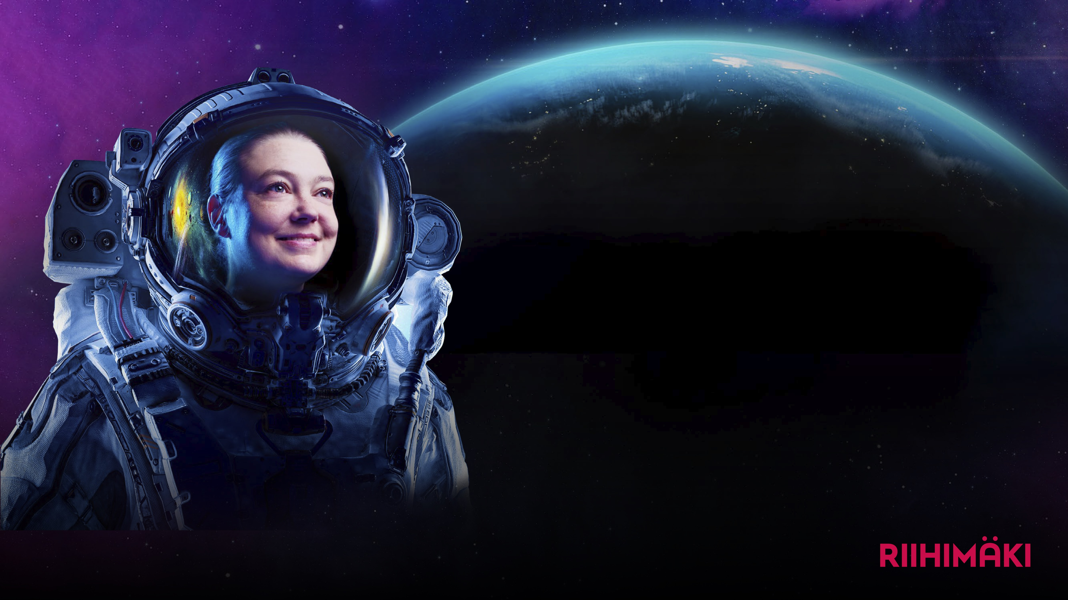
RAKA SRIKSU2035
STR ATE GY: OBJECTIVES
We create well-being for the residents of Riihimäki through high-quality education and culture, and versatile learning opportunities.
We ensure that our education is of an outstanding quality. We recognize the future needs of working life thus creating a foundation for Riihimäki’s growth and for strong trade and industry.
We develop our residents’ and our staff’s future skills. These future skills are founded on creativity, problem-solving, collective working, and digital skills, as well as empathy and emotional intelligence.
Riihimäki is Finland’s internationally recognized capital city of robotics where high-quality robotics education extends from early childhood to higher education. Our applied robotics research and development skills cluster creates new study places, jobs and companies.
International collaboration increases Riihimäki’s recognition and attraction. We are also known as future-makers within theatrical arts.
COURAGE
The home of future-makers

Slide 5
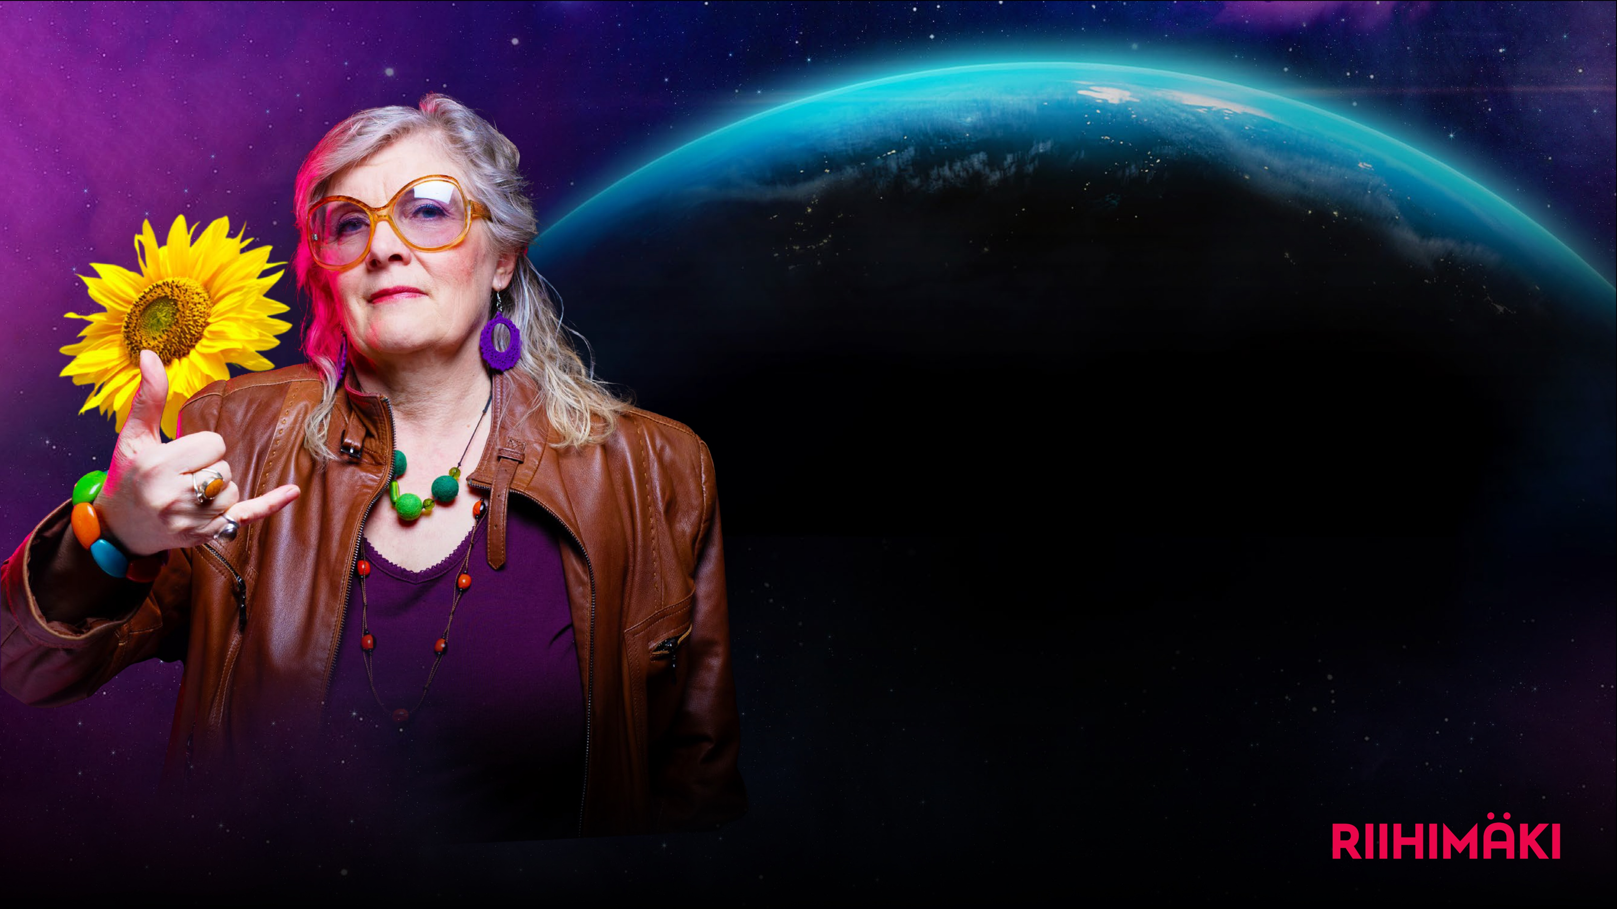
RAKA SRIKSU2035
STR ATE GY: OBJECTIVES
FAIRNESS
We aim for permanent population growth. We are building more homes and providing more plots for businesses. We are developing the station area and creating versatile living options in the whole Riihimäki region.
We help local companies to thrive and work actively to attract new companies to Riihimäki.
We are a carbon neutral city. We strive towards zero-emission, zero-waste and sustainable use of natural resources. We use renewable energy. Circular economies are a significant part of our business activities.
Our diverse nature is close by and easily accessible. We look after the environment through our own actions.
We develop our leadership, support our staff’s well-being, and ensure that we are seen as a great employer.
We manage the city’s finances and property in a systematic, responsible, and balanced way. We take into account demographic changes.
Sustainable growth community

